Slide 1
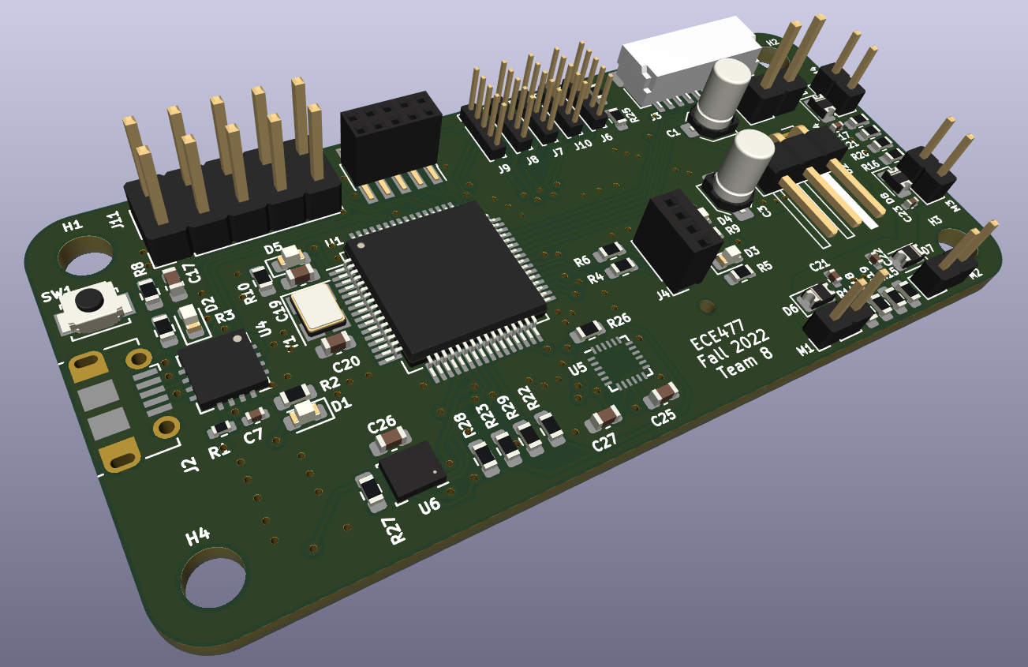
ECE477 Midterm Design Review: Team #8
Notes:
Introduce each of us to the panel and our project Hermes. Maybe explain our roles? (not too sure exactly what we NEED to do for the panel that is reviewing us)

Slide 2
Outline
Project Overview
Project Specific Success Criteria
Major Components
Block Diagram
Packaging Design
Electrical Schematic
PCB Layout
Prototyping Progress
Software Development Status
Project Timeline
Questions
Notes:
Quickly go over the agenda for the session, don’t spend much time at all on this slide

Slide 3
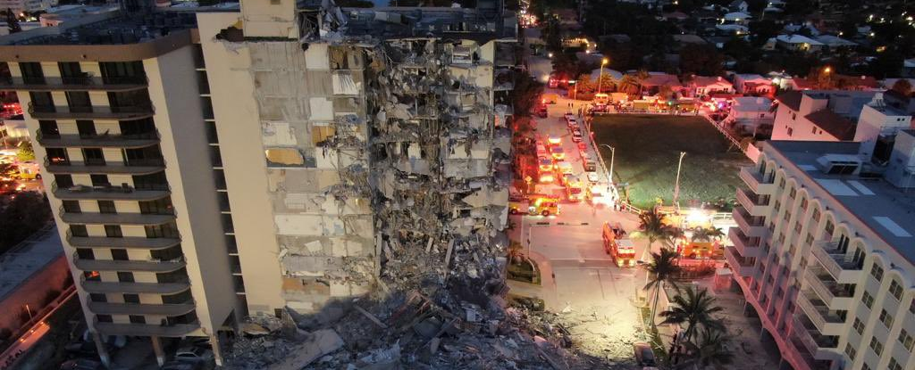
Application:
Search Operations inside a collapsed building are very hazardous for the people involved
This situation involves narrow passageways and walls, which our project is well suited to navigate.
Our drone could be best suited to aid these search and rescue operations

Slide 4
Project Overview
Objectives and goals
Hermes is a semi-autonomous drone with the ability to navigate along walls and maintain a set distance from the ground, and find an object on the ground using image recognition
The drone will utilize a custom flight controller and a navigation computer
The navigation will utilize proximity sensor reading to the walls and floor to guide the search pattern
The flight controller will respond to dictated flight control commands from the navigation computer via a digital communication link, or a remote control based on dictated flight mode
Notes:
Look to expand on all the points, including the intended use case (search and rescue) as well as expand on the potential stretch goals/future hopefuls like better autonomy, additional sensors onboard, expanded battery etc. Also, fully explain what GENERALLY is being used for components (MCU, 6 axis gyro, LiDAR sensors (just don’t be specific as that comes later)), just overall explain what is being used to accomplish goals stated in bullet points

Slide 5
PSSCs
Project Specific Success Criteria
PSSC #1 (Hardware): An ability to read controller joystick axis channel values from incoming signal from off the shelf radio receiver (via CRSF)
PSSC #2 (Hardware): An ability to send and receive navigation command and IMU sensor data between an onboard single-board computer and flight controller microcontroller (via UART)
PSSC #3 (Hardware): An ability to send signals to a motor controller and control speed of all 4 motors simultaneously (via PWM)
PSSC #4 (Hardware): An ability to communicate with and read sensor data off a gyroscope & accelerometer (via SPI)
PSSC #5 (Hardware): An ability to measure distance to walls or floor from time-of-flight proximity sensor (vis I2C)
Notes:
I’m pretty sure this slide is not to be presented in the actual presentation

Slide 6
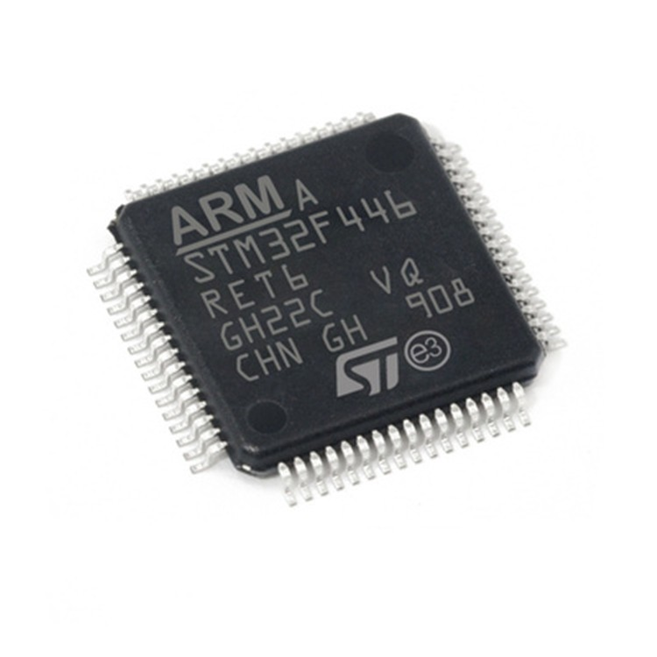
Major Components
Microcontroller
Chosen Microcontroller: STM32F446RE
Data Bus Width: 8 or 16bit
Clock Speed: 180 MHz
Operating Voltage: 1.8V to 3.6V
4 SPI connections
6 UART connections
3 I2C connections
Notes:
Talk about why we are using an STM32F4 and then why it beat out the STM32F411CE and STM32F417VE as well as other STM32F4 class chips. Talk about what SPI, UART and I2C connections are being used on the device

Slide 7
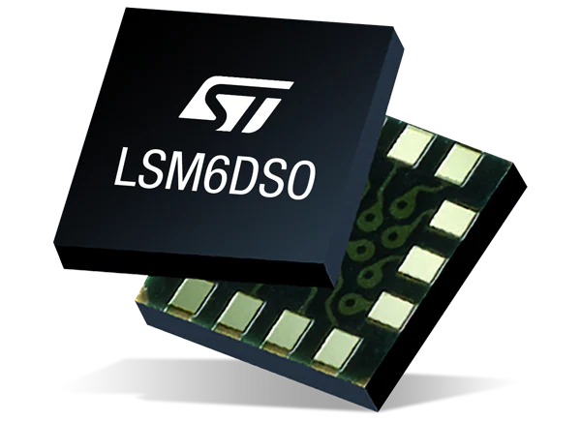
Major Components
IMU
Chosen IMU: LSM6DSOWTR
Communication Protocol: I2C or SPI
Operating Voltage: 1.7V to 3.8V
Gyroscope Full Scale: ±250dps, ±500dps, ±1000dps, ±2000dps
Accelerometer Full Scale: ±2g, ±4g, ±8g, ±16g
Notes:
Talk about why we are using a single 6-axis gyro/accel combo instead of 2 separate devices (one gyro and one accel). Talk about why we are using SPI over I2C

Slide 8
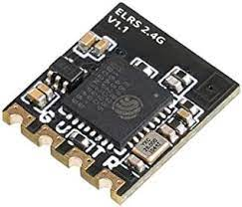
Major Components
Radio Receiver
Chosen Radio Receiver: BetaFPV ELRS Lite
Operating Voltage: 5V
Operating Frequency: 2.4 GHz
Communication Protocol: Crossfire UART
Notes:
Talk about why we chose this Radio Receiver over other Radio Receivers on the market (like the RadioMasterR834 V2 (weight, using UART versus PWM)). Explain the differences in Crossfire UART and normal UART communication.

Slide 9
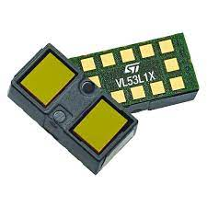
Major Components
LiDAR Sensor
Chosen LiDAR Time-of-Flight Sensor: VL53L1X
Operating Voltage: 2.6V to 3.5V
Communication Protocol: I2C
Max Operating Frequency: 400kHz
Field of View: 15 to 27 degrees
Notes:
Talk about why we chose this LiDAR sensor in particular. Talk about differences between this one and the newer/older models of the LiDAR sensors. Potentially hit on why we are using a ToF sensor instead of other methods.

Slide 10
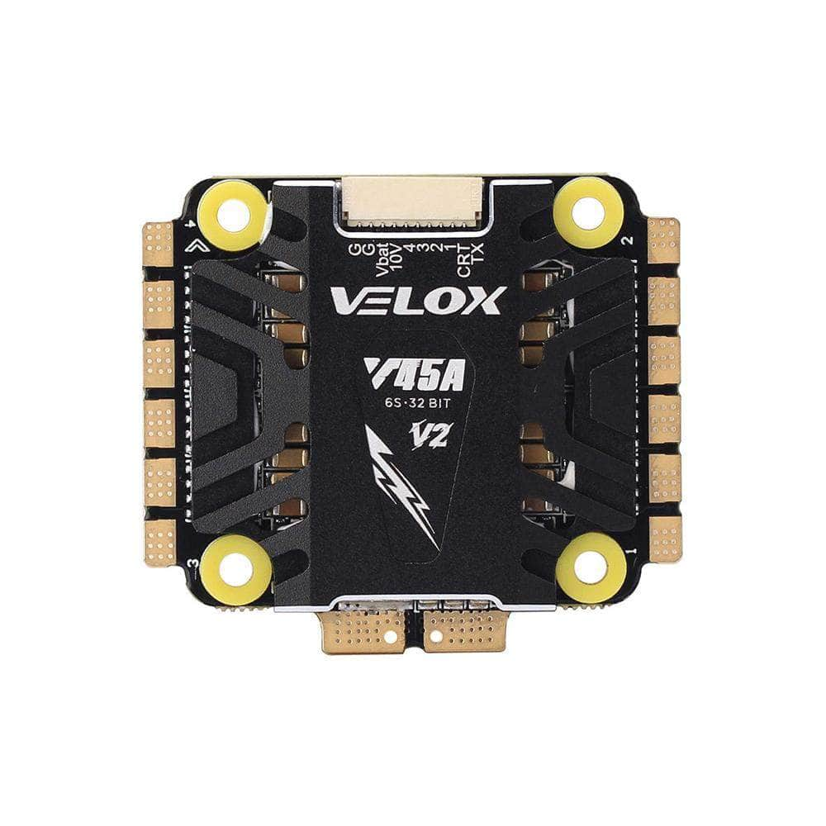
Major Components
ESC
Chosen ESC: T-Motor Velox V2 32Bit 45A 3-6S 30x30 4in1 ESC
Max Current Draw: 55A
Communication Protocol: DSHOT, PWM
Weight: 21g
Size: 46.4mmx41mmx7mm
Notes:
Talk about why we used this ESC in particular (why it’s so overkill for a drone this size and the reason behind using it). Why we are using PWM and not DSHOT is another good point to bring up

Slide 11
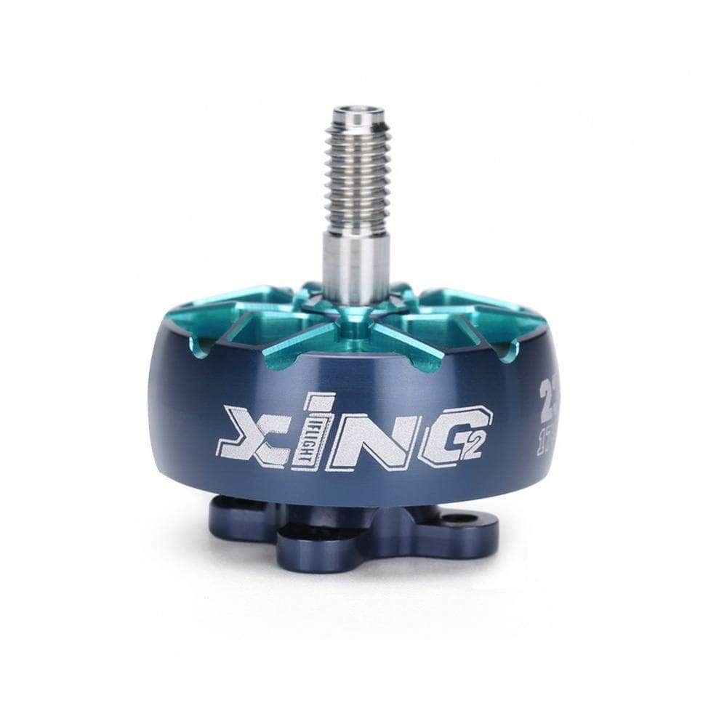
Major Components
Motors
Chosen Motors: iFlight Xing2 2306 2555Kv Motor
KV: 2555Kv
Input Voltage: 4S LiPo
Weight: 31.6g each
Max Current Draw: 51.30A
Internal Resistance: 50mOhm
Notes:
Talk about why we chose these motors in particular. Talk about the max thrust that they provide versus the weight of all our drone stuff.

Slide 12
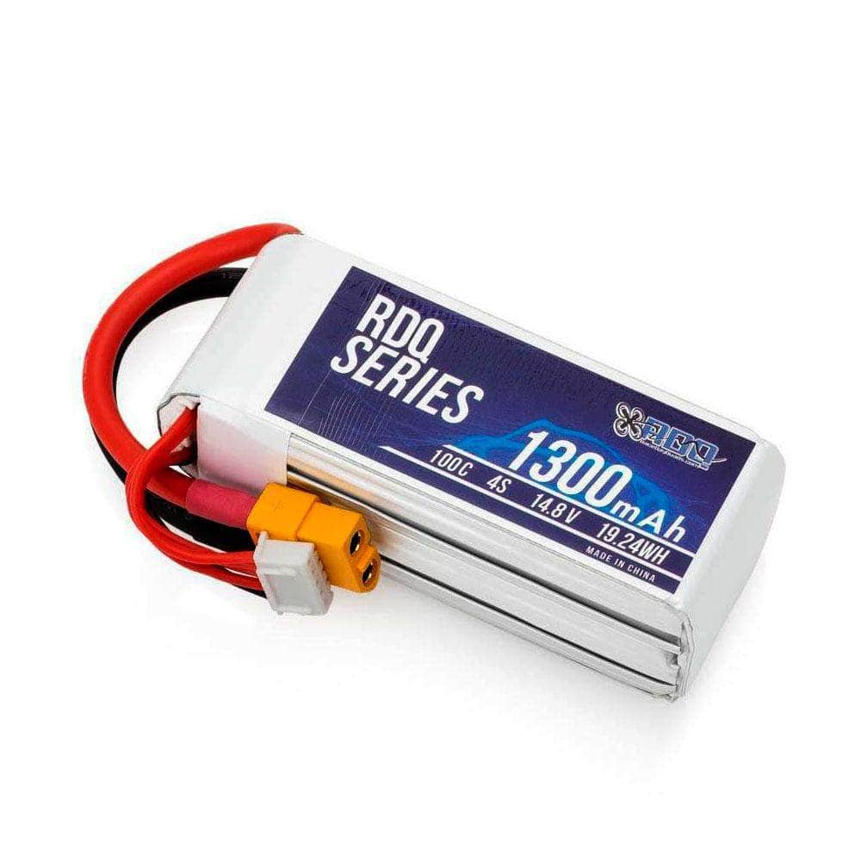
Major Components
Battery
Chosen Battery: 4S 15.2V LiPo Battery
Max charge Voltage: 15.2V
Capacity: 1300mAh
Max. Continuous Discharge: 100C
Dimensions: 34x35x78mm
XT60 Lead: 85mm
Weight: 164g
Notes:
Talk about why we chose this Battery in particular (specifically approx. flight time it gives us, size, and why we are using a LiPo battery instead of other options like Liion)

Slide 13
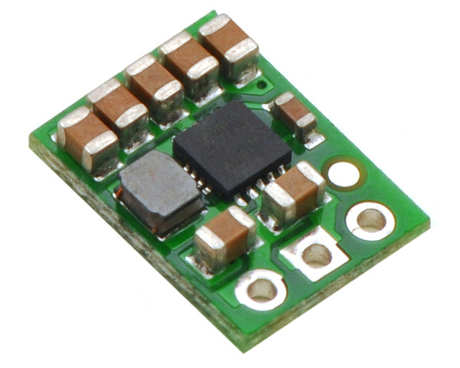
Major Components
Voltage Regulator
Chosen Voltage Regulator: Pololu 5V Step-Up/Step-Down Voltage Regulator
Voltage Input: 2.7V-11.8V
Voltage Outputs: 5V
Max Current: 1A when step down, 500mA when step up
Size: 9x12x3mm
Notes:
Talk about why we chose this voltage regulator. Talk a little bit now on the size it will take up on the PCB and why need the voltage outputs it is outputting. This slide should lead directly into the Block Diagrams so further explanation on where all the output voltage is going should be fully elaborated on there

Slide 14
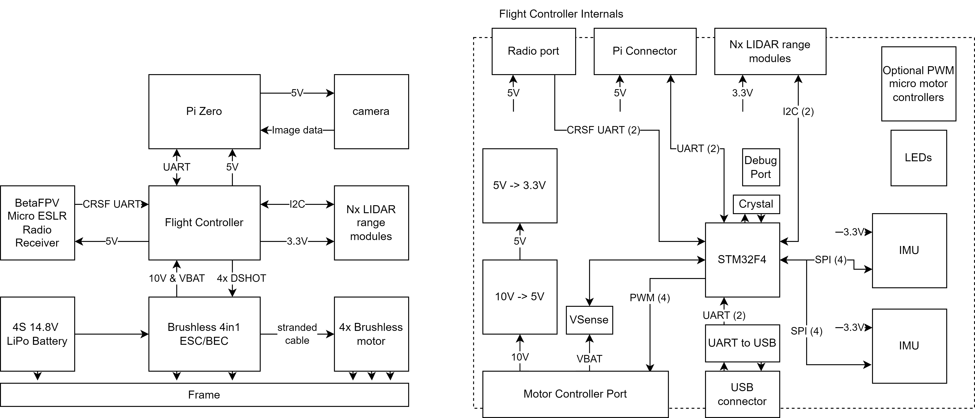
Block Diagram
High Level Block Diagram
Notes:
Go over the overall flow of the drone, explain the main connections from each component to another, wait for specifics on each intercommunication protocol specifics for next slide. Also explain the non-labelled arrows on the diagram (the mounting to the frame, LiPO battery provides power to ESC, etc.)

Slide 15
Block Diagram
Flight controller internal Level
Notes:
Go in depth on each of the protocols being used to communicate with each of the blocks, and why each one was chosen for that part (as explained in the previous Major Components design slides). Each of us should explain the protocol that we programmed, and explain what we are using to run each one (so if DMA is being used to drive one of the protocols explain that, potentially go into what pins are being used, libraries being used for programming, differences between UART and CRSF UART, PWM versus DSHOT, etc.)

Slide 16
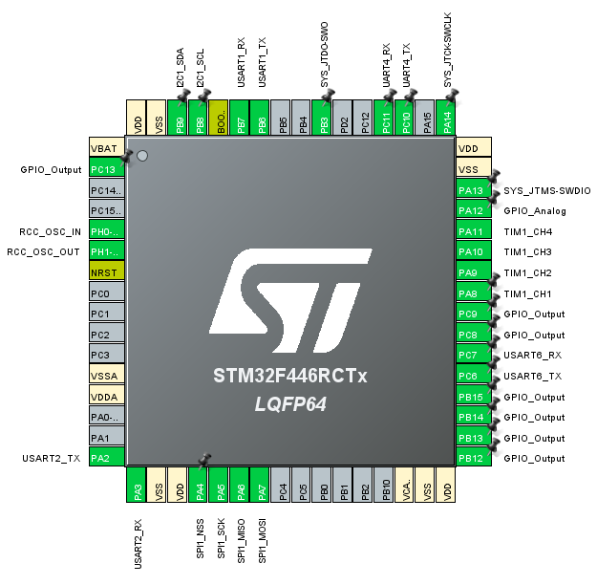

Block Diagram
Microcontroller Pin selections
I2C1
USART1
USART2
USART4
USART6
SPI1
TIM1 PWM
GPIO
Notes:
Describe how pin selections were chosen to prevent any hardware protocol driver from trying to use the same pins as another

Slide 17
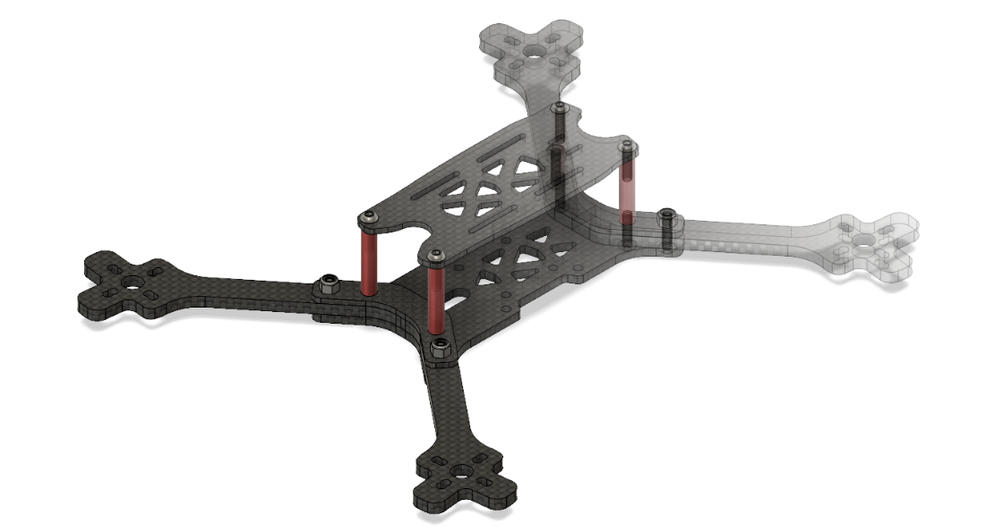
Packaging Design
Package design for the entire drone
Purchased for reliability and security of PCB and other fragile electronics
ESC will be placed on the bottom with the Pi Zero placed above and on top our PCB in the center of the drone
Notes:
Need to go over dimensions of the drone, dimensions of the board, how the assembly is going to be placed on the drone (ESC, MCU, Pi, or whatever we wanted to do) PCB approx. dim: 30mm x 65mm
Drone Frame approx. dim:
Wheelbase 5": 220 mm
Top plate: 2 mm
Bottom plate: 3 mm
Standoff height: 25 mm
Arm thickness 5": 4 mm
Stack mounting: 30.5 × 30.5 mm & 20 × 20 mm
Weight: 72 g
(Taken from RDQ website)

Slide 18
Packaging Design
PCB 3D Model
Notes:
Need to go over dimensions of the drone, dimensions of the board, how the assembly is going to be placed on the drone (ESC, MCU, Pi, or whatever we wanted to do) PCB approx. dim: 30mm x 65mm
Drone Frame approx. dim:
Wheelbase 5": 220 mm
Top plate: 2 mm
Bottom plate: 3 mm
Standoff height: 25 mm
Arm thickness 5": 4 mm
Stack mounting: 30.5 × 30.5 mm & 20 × 20 mm
Weight: 72 g
(Taken from RDQ website)

Slide 19
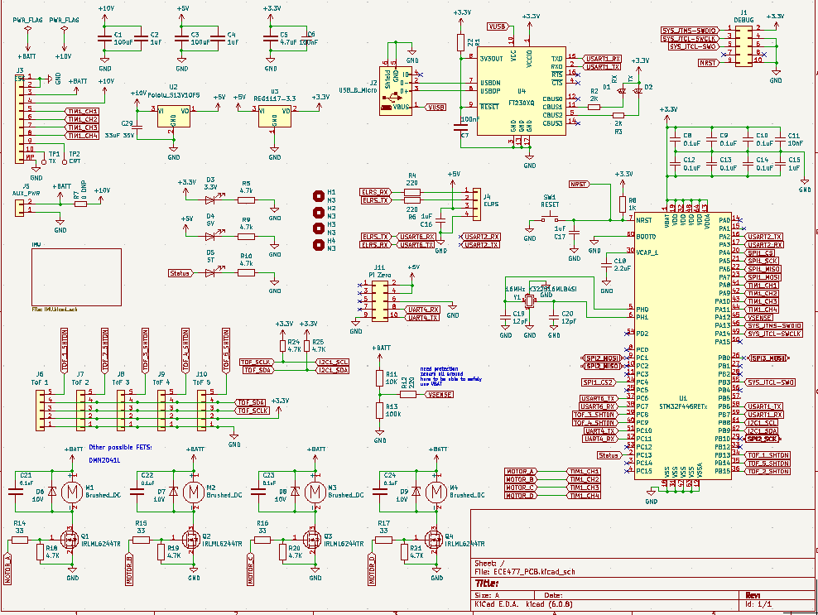
Electrical Schematic
Overall schematic
Notes:
Not much to say as this is a bit of a zoomed out view and hard to read but just generally talk about all the different segments of the schematic and point to some of the diagrams not shown in the schematic/PCB slides below

Slide 20
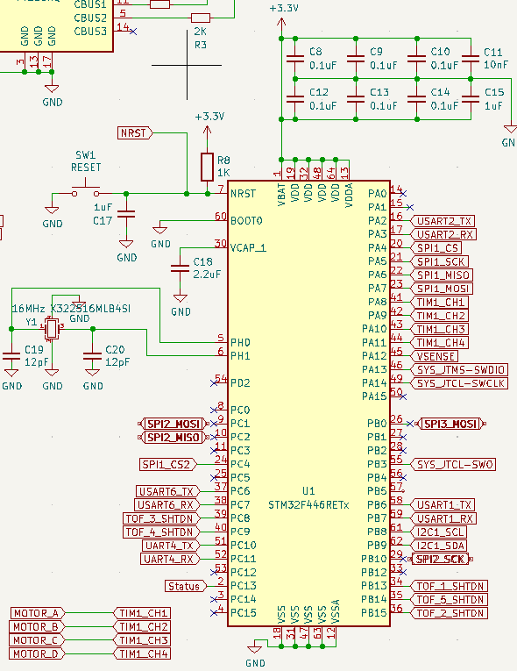
Electrical Schematic
Overall MCU Connections
Notes:
Not much to say as this is a bit of a zoomed out view and hard to read but just generally talk about why we are using so many pins and is a good introduction to the rest of the electrical connections

Slide 21
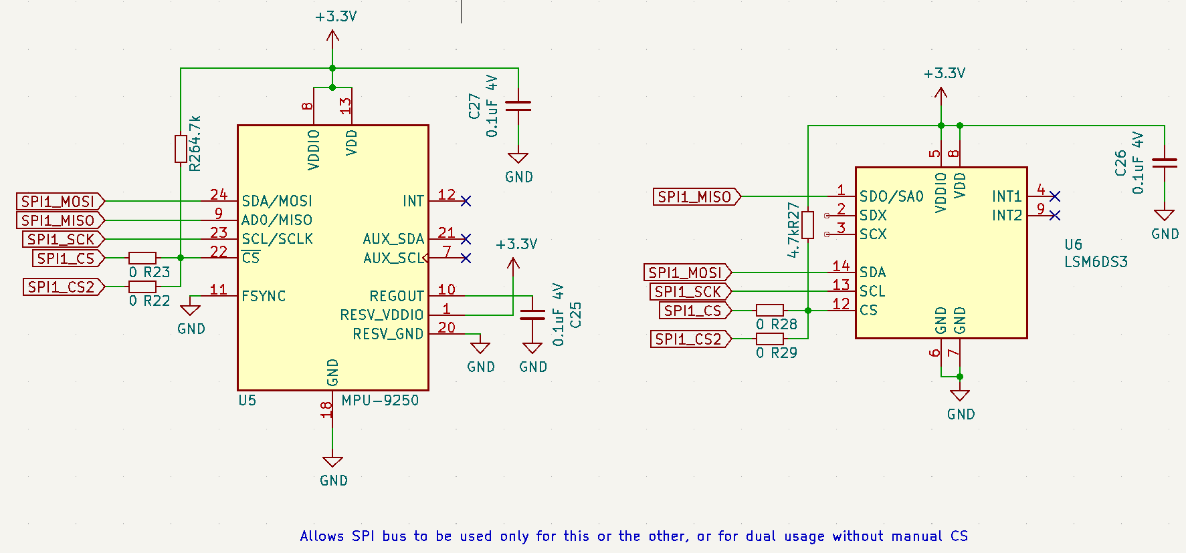
Electrical Schematic
IMU Connections
Notes:
Explain purpose of both IMUs and the special 0 ohm switch setup

Slide 22
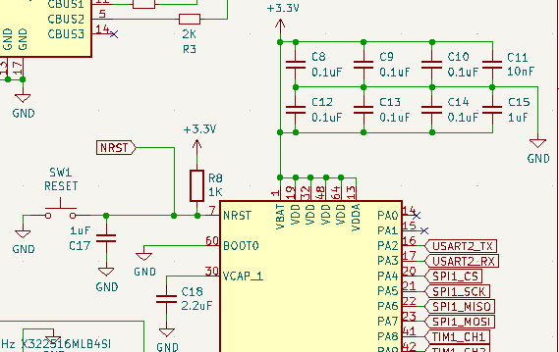
Electrical Schematic
MCU power And Reset Management
Notes:
Go over decoupling capacitors used for all the power on the microcontroller. Also go over the reset switch and how it will be mounted on the PCB (to be shown later). Probably going to have to explain reasonings for using 0.1uF

Slide 23
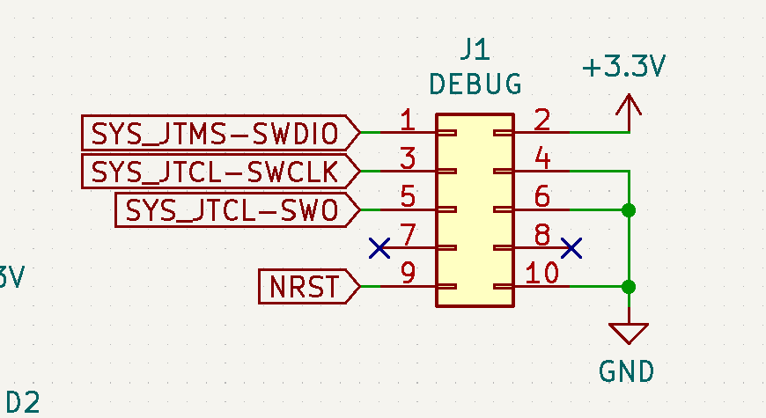
Electrical Schematic
MCU Debug module
Notes:
Just explain that we HAVE the debug modules needed to reprogram and reset the MCU. Not here to explain the physical connections on the board, mainly just there to show that we actually have the debug utility

Slide 24
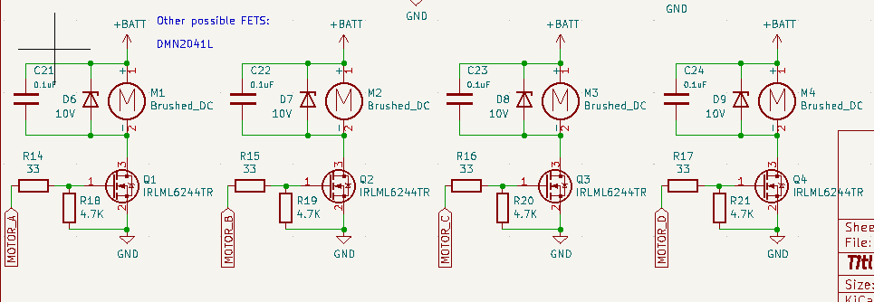
Electrical Schematic
Motor Connections
Notes:
Just need to explain why the motors are hooked up to the board the way they are. Explain why we are using the IRLML6244TR MOSFET as well as the diode between the positive and negative ends of the motor

Slide 25
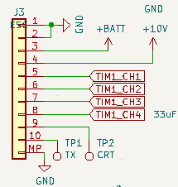
Electrical Schematic
ESC Connection
Notes:
This one is pretty simple. Just explain generally what TIM1 is being used for and why it needs battery voltage and 10V

Slide 26
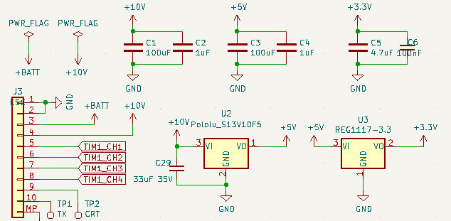
Electrical Schematic
Overall MCU Connections
Notes:
Again only thing really to explain here is the onboard connections of the voltage regulators and potentially might need to explain why we are using 100uF and 1uF capacitors

Slide 27
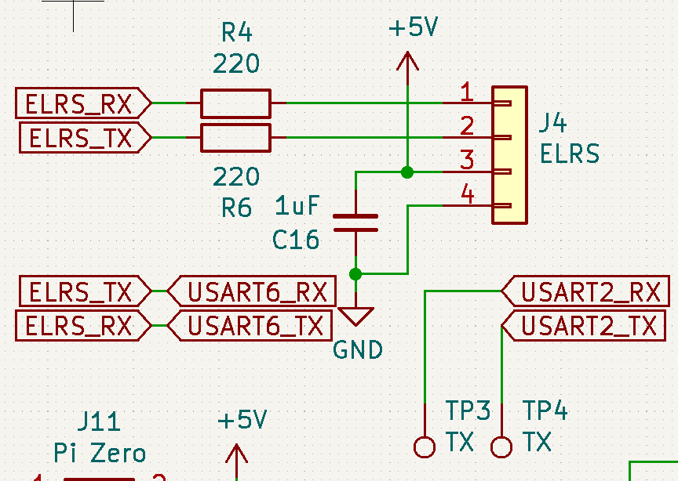
Electrical Schematic
ELRS Radio Receiver Connection
Notes:
Just need to potentially explain why the resistors are needed at 220 Ohms and why we are using a 1uF capacitor. Maybe a question on the labelling but I doubt it.
Explain the test points for optional use of USART2

Slide 28
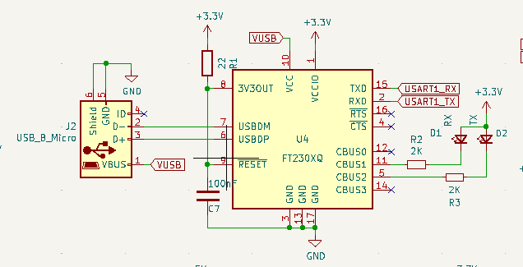
Electrical Schematic
USB USART Connection
Notes:
Same thing as the other electrical schematic slides. I don’t see too many problems arising with this slide. Maybe expect to explain VUSB as well as the null connection terminals and Reset BAR

Slide 29
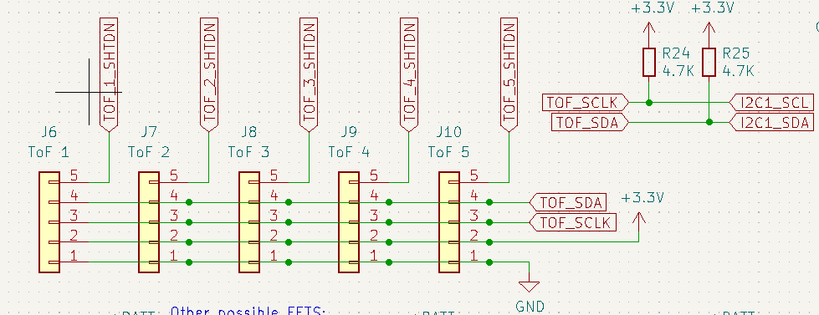
Electrical Schematic
LiDAR time of Flight Sensor Connections
Notes:
This one will most likely need an explanation that’s a bit more detailed as it will need to be elaborated that the LiDAR sensors will not be on the mainboard, and instead be on daughterboards. Might have to explain why SDA and SCLK is tied to all of them (might want to explain why we want all LiDAR data to be synchronous and not individually polled)

Slide 30
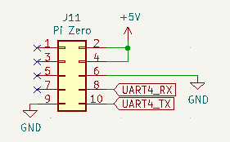
Electrical Schematic
Pi Zero Connections
Notes:
This one should cause no problems. Its powered by 5V and communicated via UART to the MCU.

Slide 31
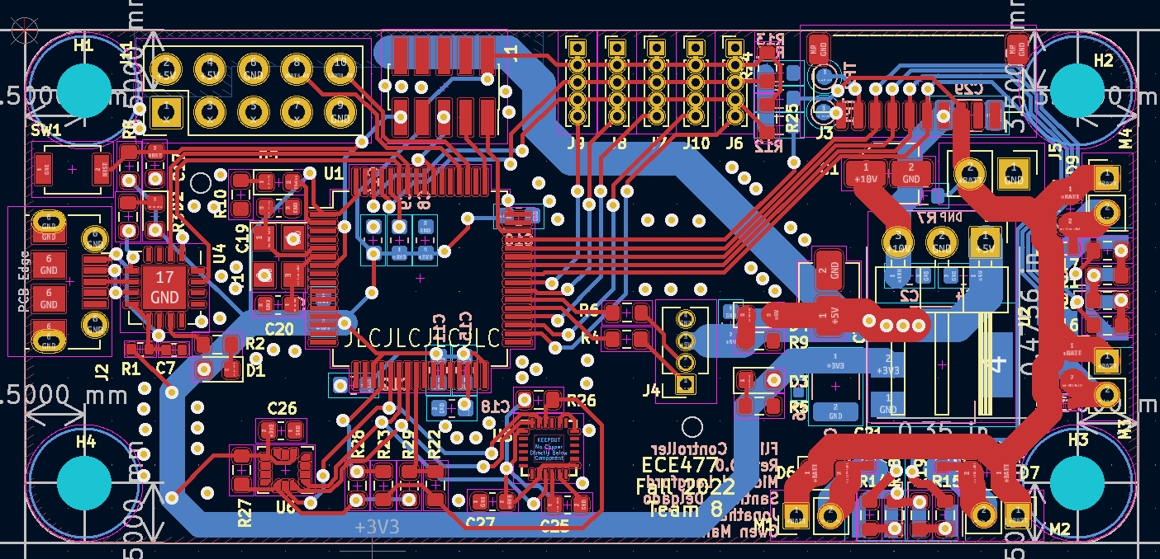
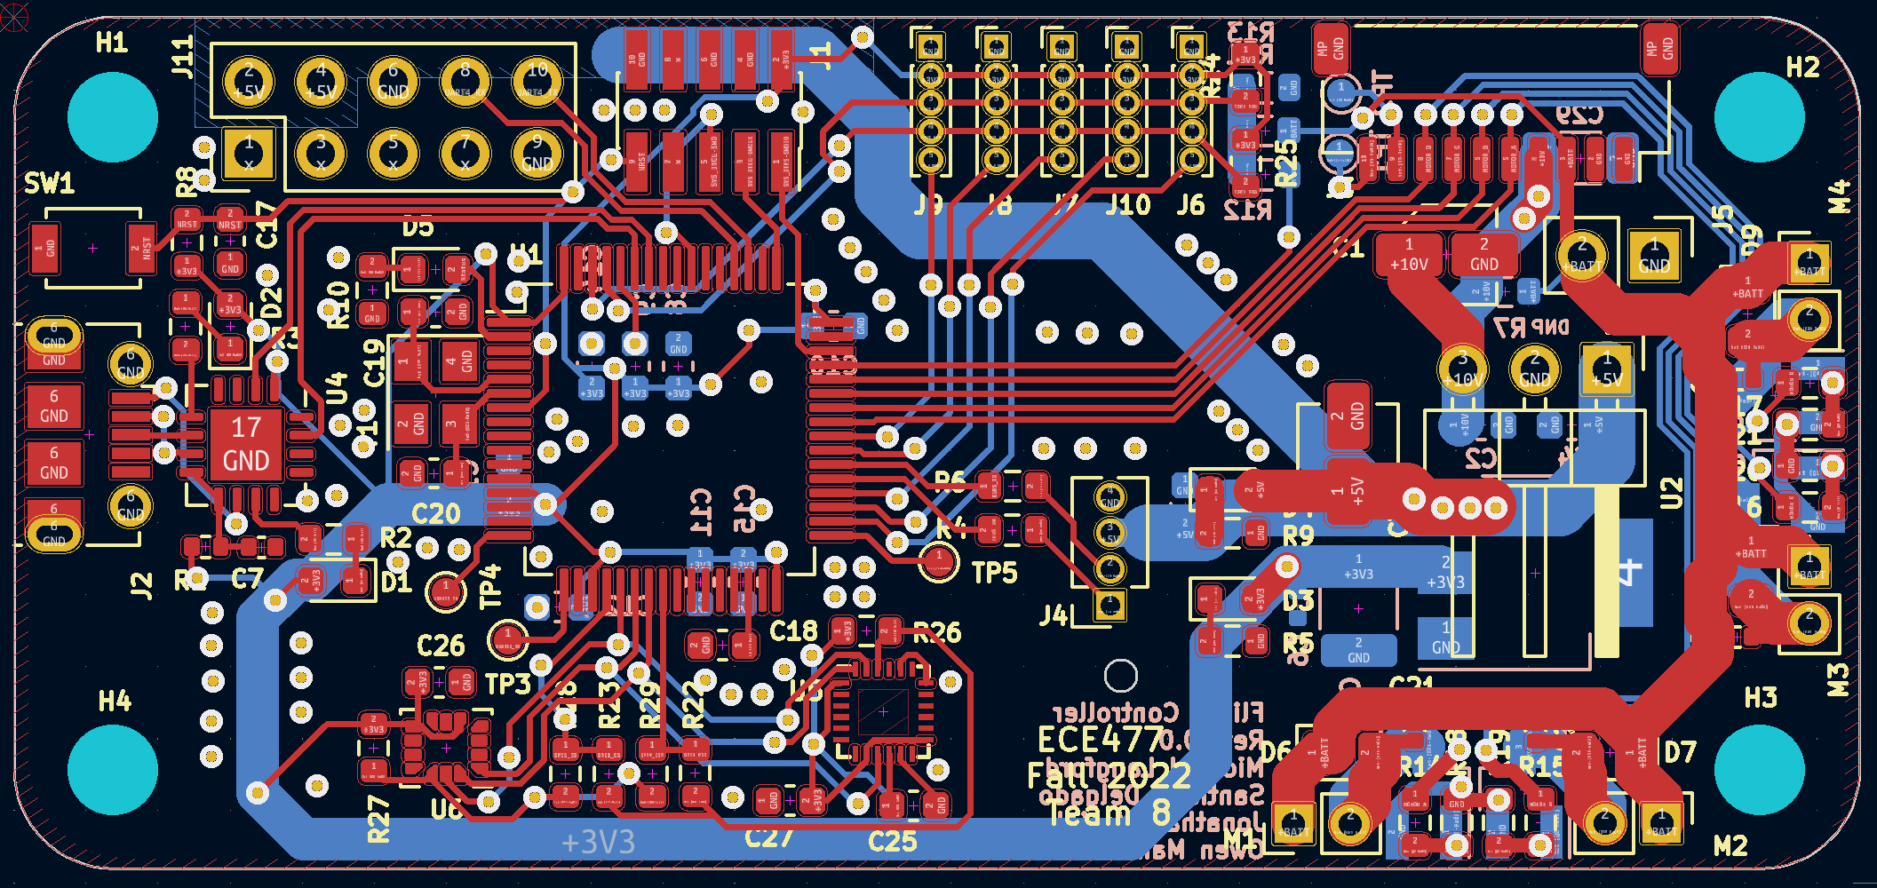
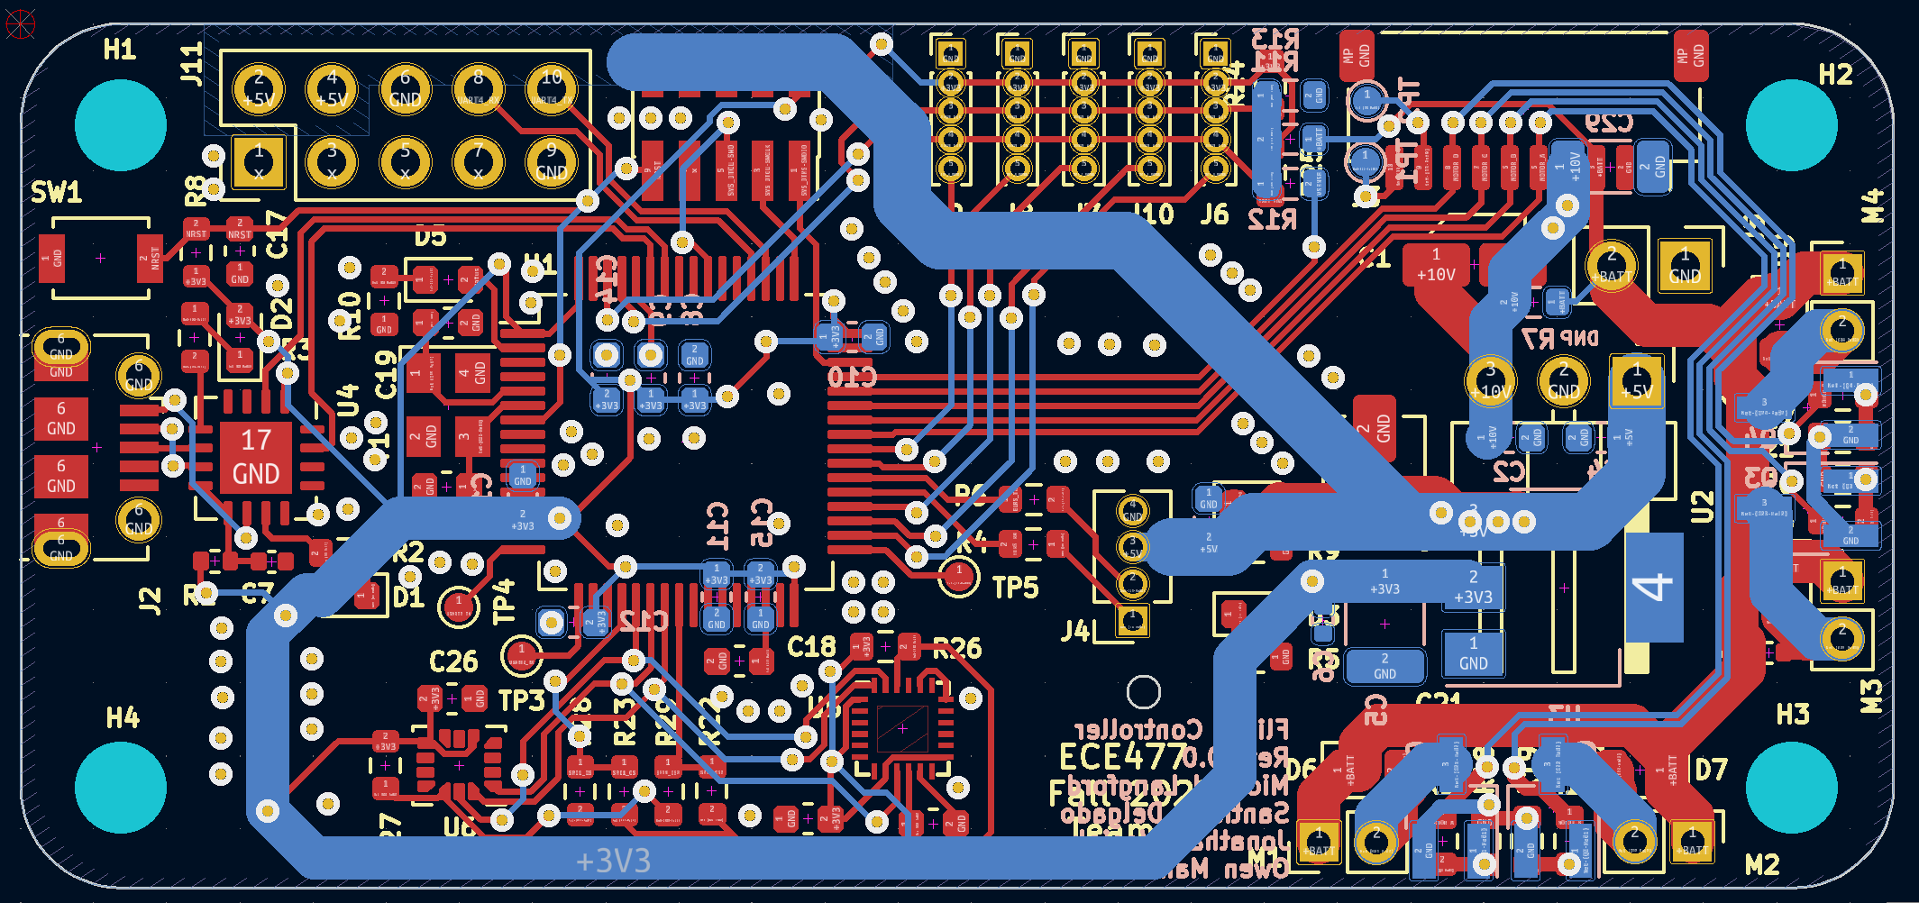
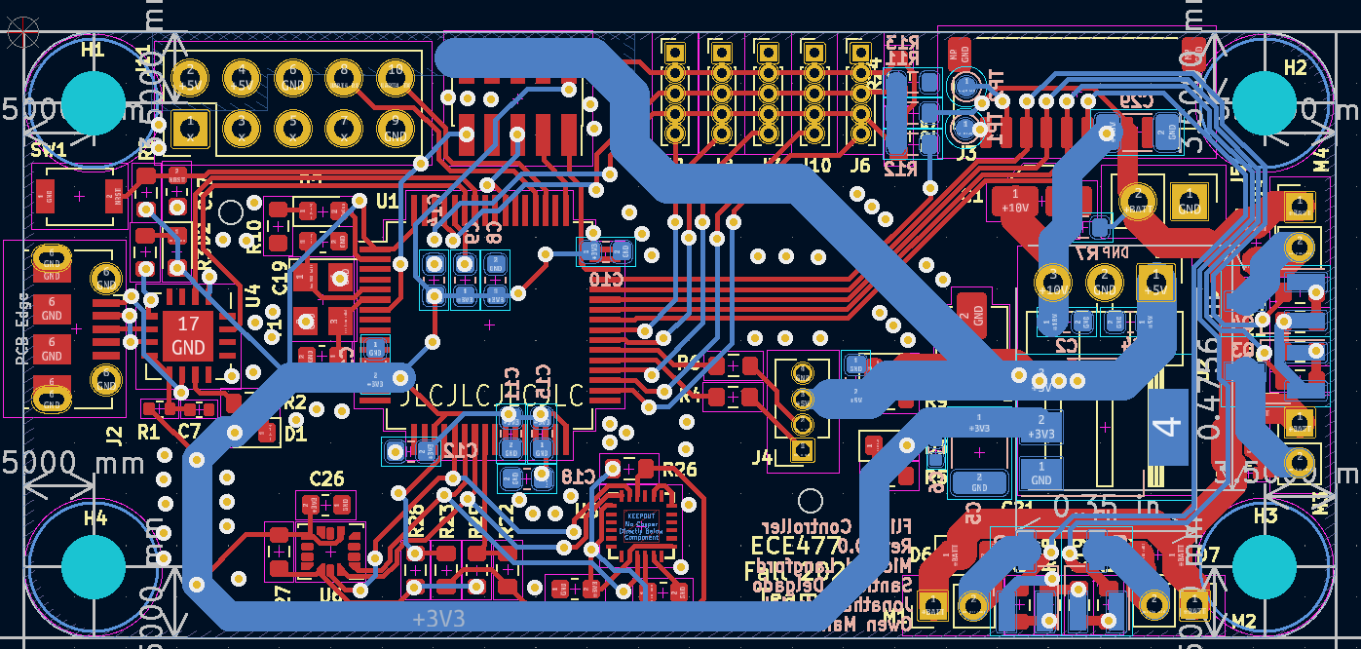
PCB Layout
Overall PCB Layout
Overall PCB Design
Overall PCB Design with Back traces on top
Notes:
Just explain that this is the overall view and talk about the dimensions of the board (65mm x 30mm)

Slide 32
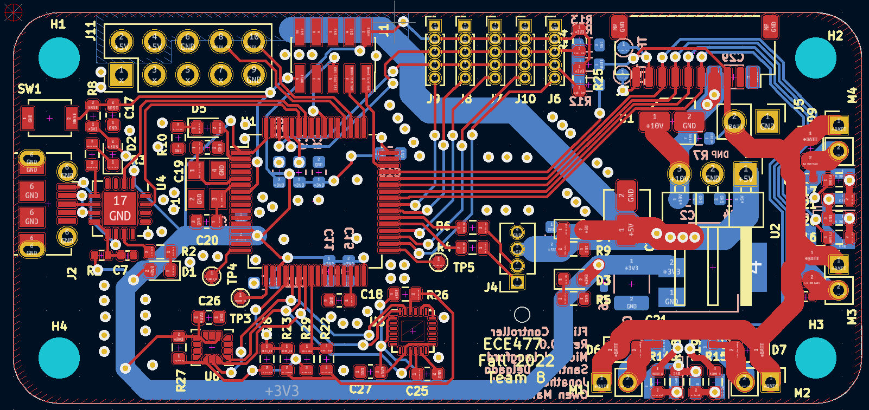
PCB Layout
Overall PCB Layout
Overall PCB Design – Full Scale
Notes:
Just explain that this is the overall view and talk about the dimensions of the board (65mm x 30mm)

Slide 33
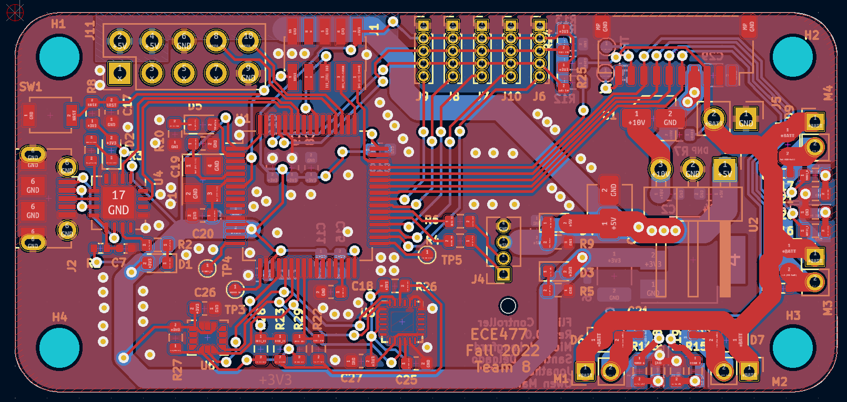
PCB Layout
Overall PCB Layout
Overall PCB Design – Full Scale, with flood pour
Notes:
Just explain that this is the overall view and talk about the dimensions of the board (65mm x 30mm)

Slide 34
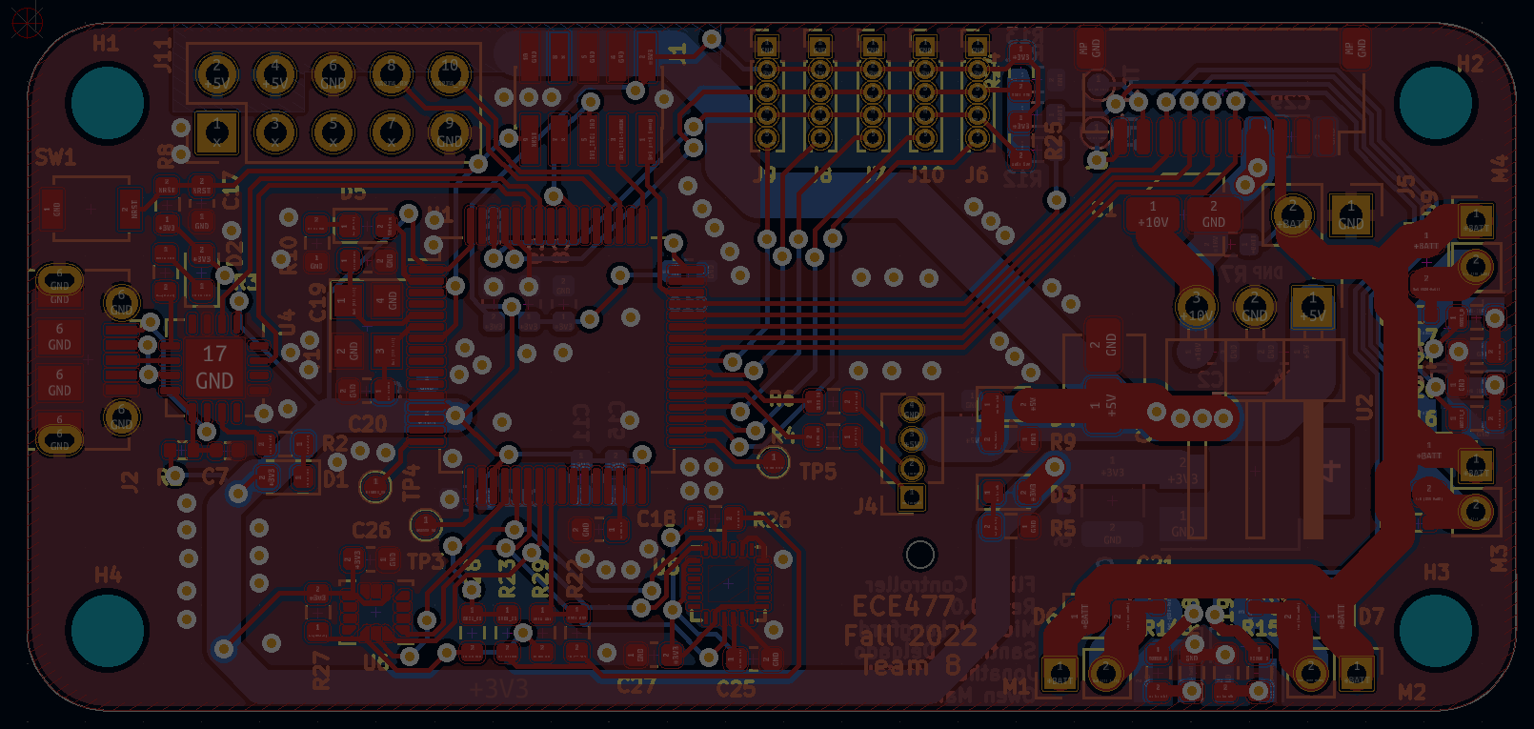
PCB Layout
Overall PCB Layout
Overall PCB Design – Regions indicated
Pi Zero header
SWD
LiDAR ToF
ESC
Reset
STM32, clock / caps
Power
USB UART
DC Motors
Radio
IMUs
DC Motors
Notes:
Just explain that this is the overall view and talk about the dimensions of the board (65mm x 30mm)

Slide 35
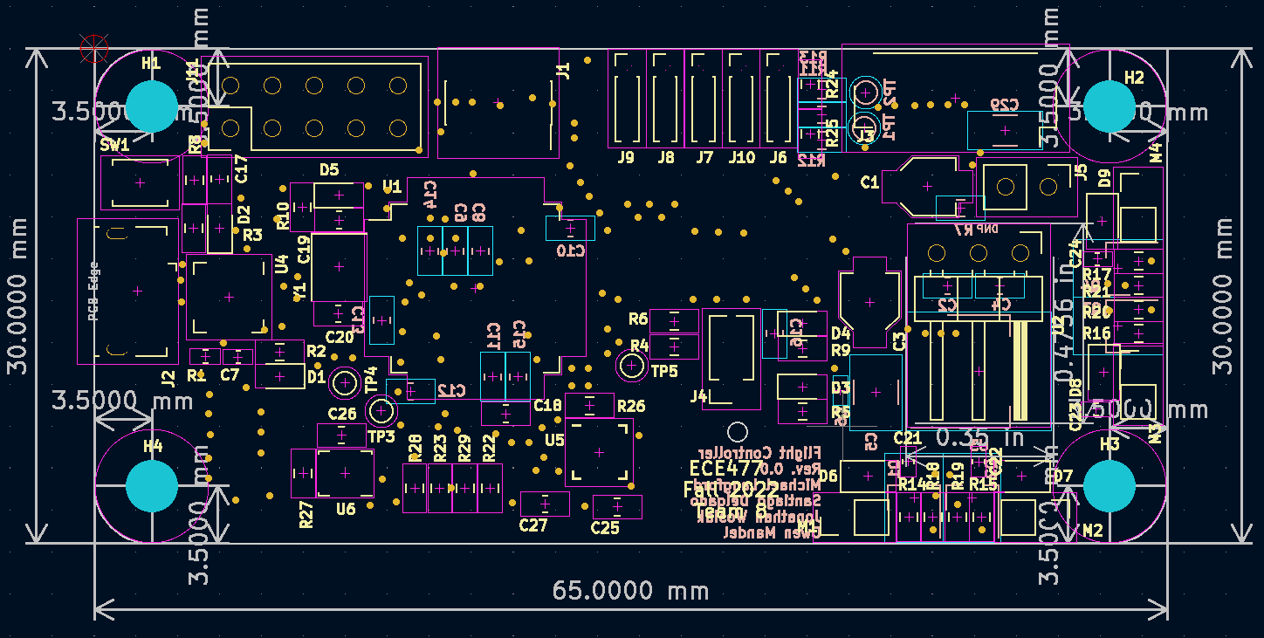
PCB Layout
Overall PCB Layout
Overall PCB Design – Silkscreen and part courtyards
Notes:
Just explain that this is the overall view and talk about the dimensions of the board (65mm x 30mm)

Slide 36
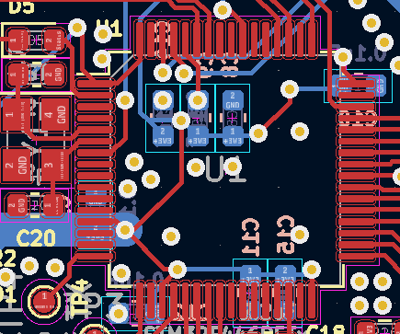
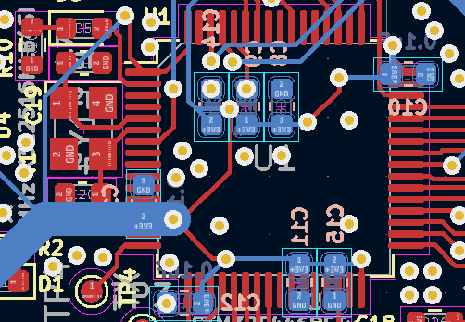
PCB Layout
MCU PCB Design connections
PCB Front
PCB Back
Notes:
Going to need to REALLY in depth on this slide. Mainly need to talk about having decoupling capacitors on the back of the board as well as the power being delivered to the board and some of the main notable connections to the board layout.

Slide 37
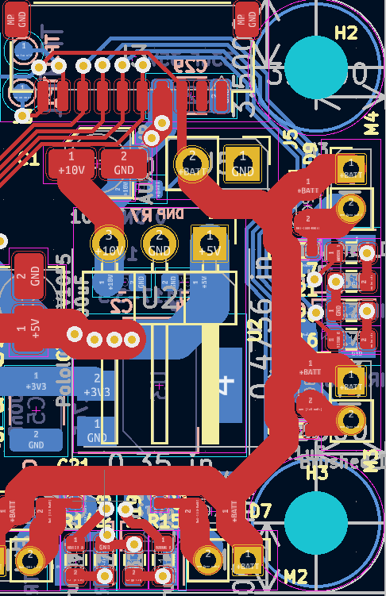
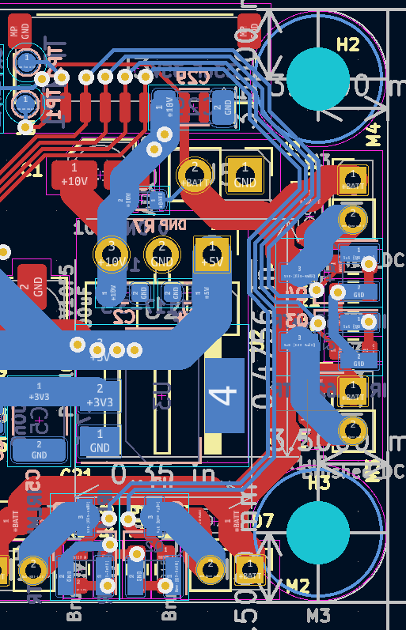
PCB Layout
Power and Voltage regulation PCB
PCB Front
PCB Back
Notes:
Again another in depth slide. Need to explain the via connection for the voltage regulator as well as all the other major connections in this section. Might need to go a bit more in depth as well on what exactly the smaller connections are as they are a bit challenging to read from these slides.

Slide 38
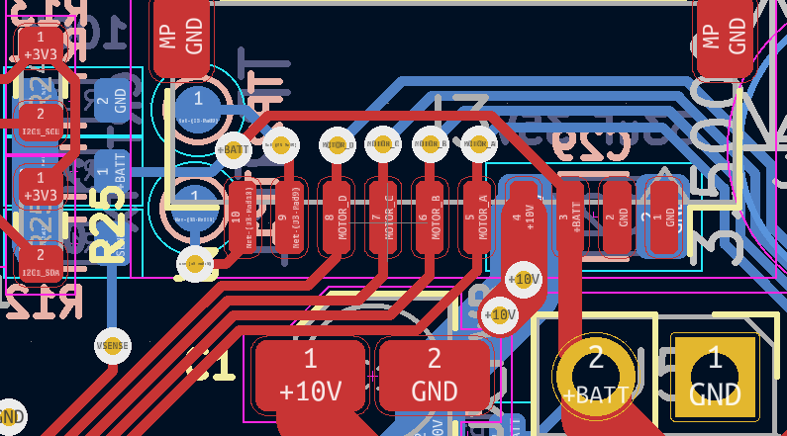
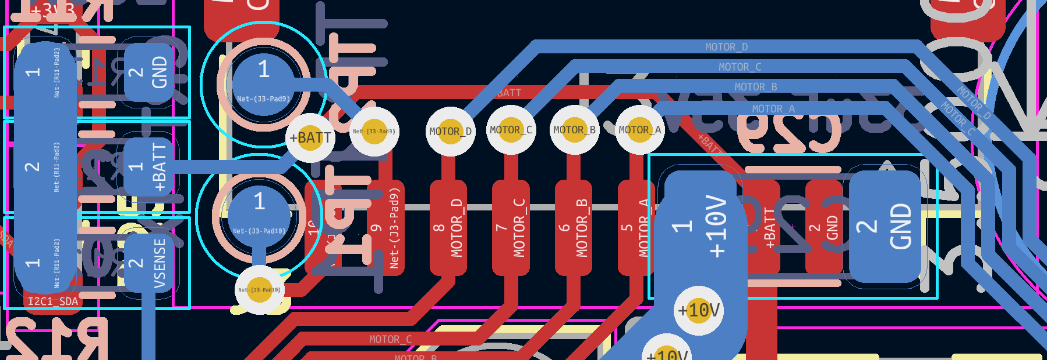
PCB Layout
Motor and Battery Connection
PCB Front
PCB Back
Notes:
Not much to explain, just make it clear that there are dedicated pins/vias for the motors as well as the larger connections for the higher voltage/current coming from the battery

Slide 39
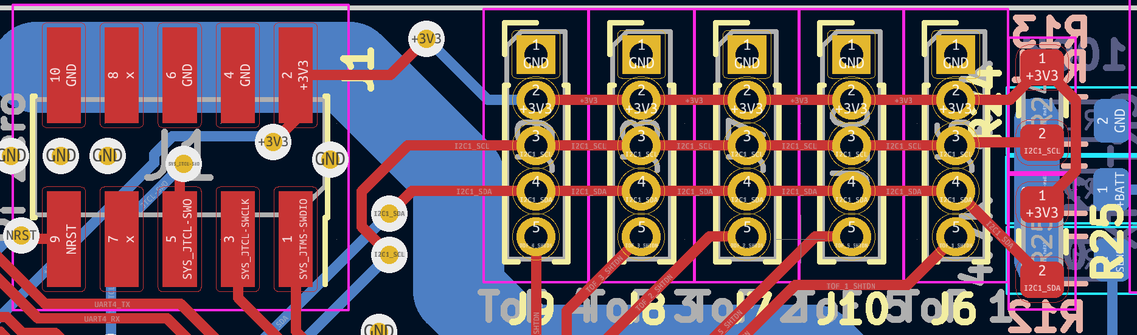
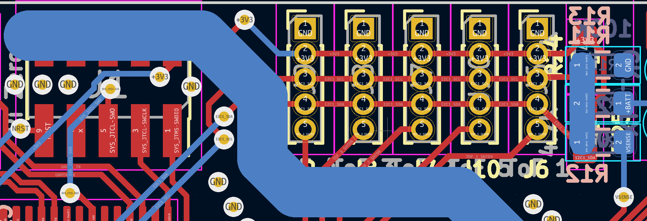
PCB Layout
LIDAR PCB Pinout
PCB Front
PCB Back
Notes:
Go over how this will be a pinout area for the I2C connection for the 5 LiDAR ToF daughter boards. Also, probably need to explain the 3.3V and ground connections for powering the boards as well as they will not be shown in this PCB design review

Slide 40
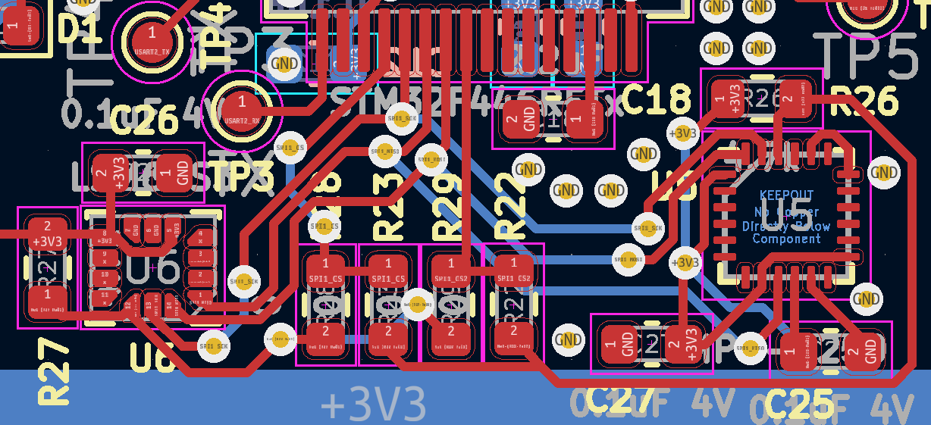
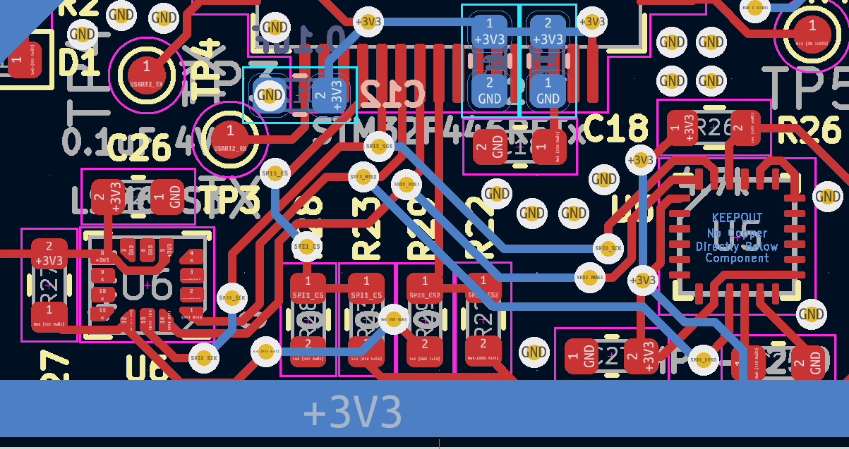
PCB Layout
IMU PCB connection
PCB Front
PCB Back
Notes:
Explain the empty slot for an additional IMU in the case of problems with the LSM6DSO 6-axis gyro. Also need to explain why the connections on each pin are being made. Power distribution will also need to be elaborated on like with the LiDAR connections

Slide 41
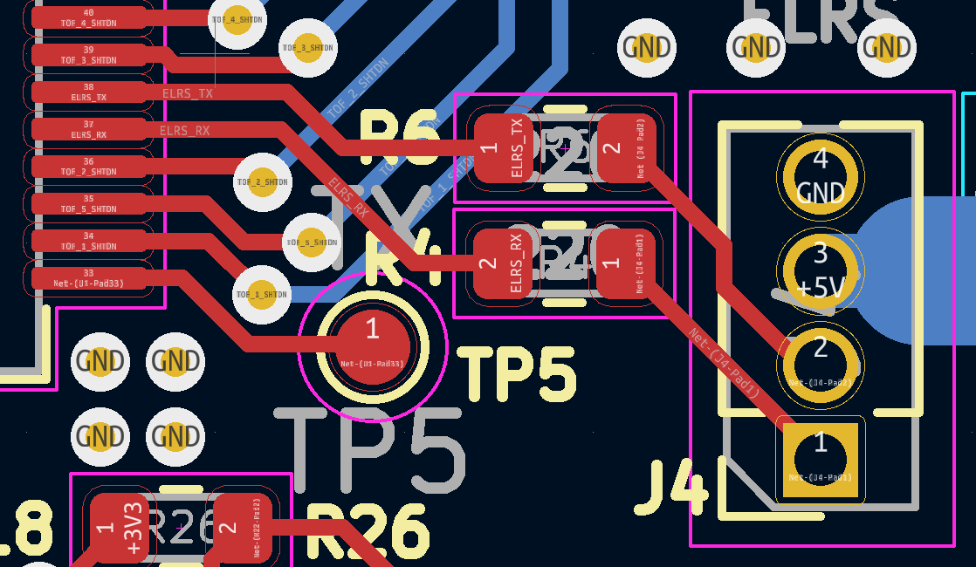
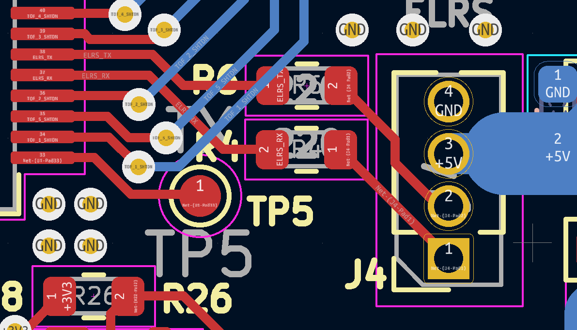
PCB Layout
ELRS Radio Receiver Connections PCB
PCB Front
PCB Back
Notes:
Explain the pinout for the Radio Receiver and how the actual receiver is not mounted directly to the PCB. Need to also potentially explain the need for the 5V connection as well as the reason for the capacitor placement

Slide 42
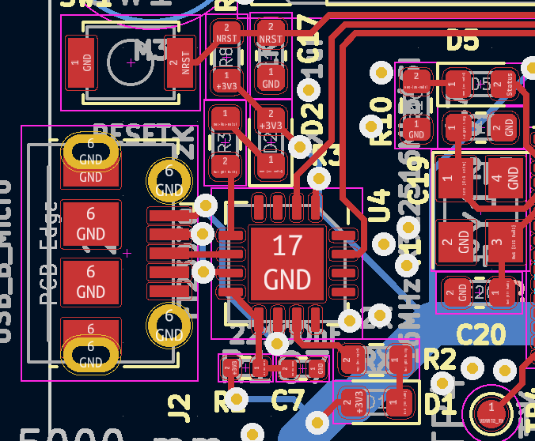
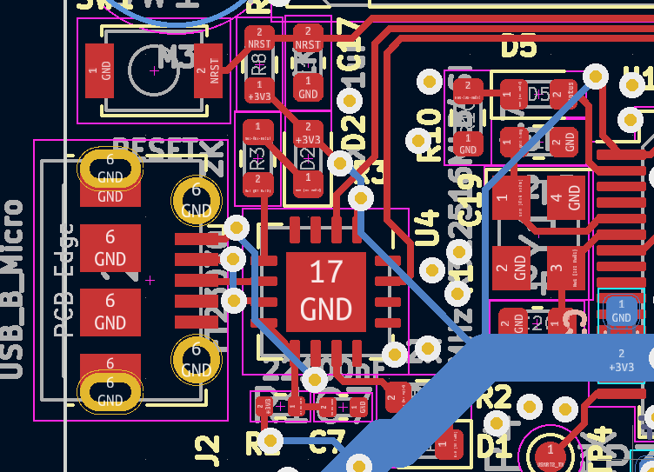
PCB Layout
USART PCB Connection
PCB Front
PCB Back
Notes:
Explain that this is not the pinout connections for the USART, but the actual chip to make that connection Kinda a lot to explain on this slide so just go over the main power to the chip, why a ground plane is being used below the chip and why certain pins are going to certain connections (mostly should’ve been explained in the electrical connections slide)

Slide 43
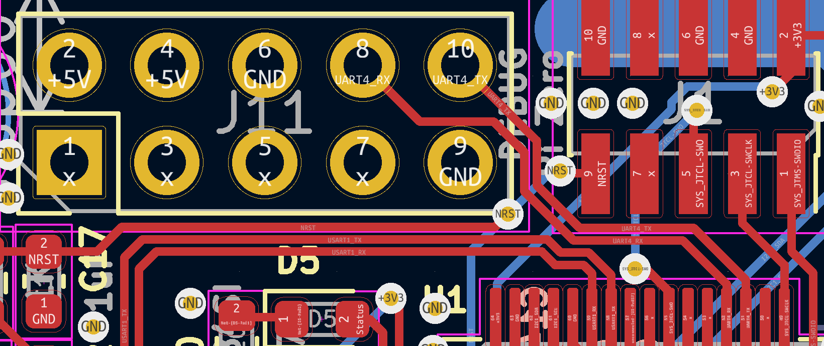
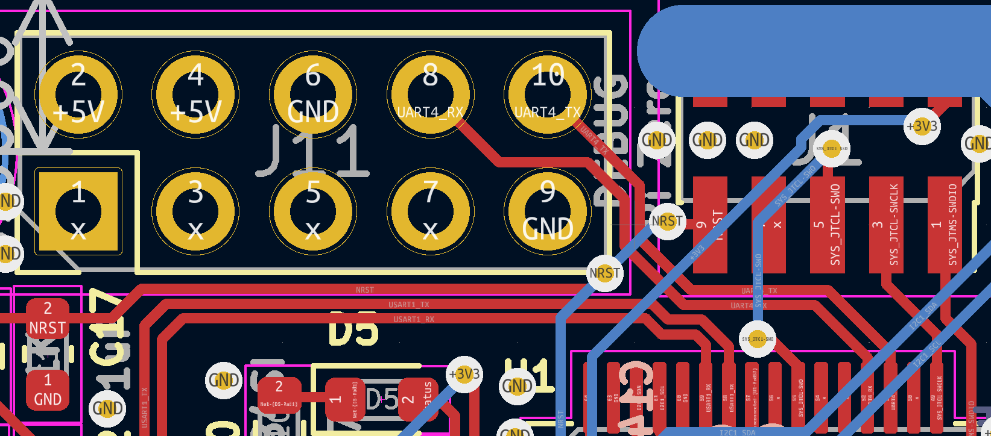
PCB Layout
Pi Zero PCB Connection
PCB Front
PCB Back
Notes:
Explain that this is the pinout connections for the PiZero’s UART connection. Explain the necessary connection with 5V power, ground as pinouts.

Slide 44
Prototyping Progress
MCU Testing done
I2C with LiDAR Time of Flight Sensor works and has been tested
SPI with LSM6DSOWTR 6-axis IMU has been tested and works
Crossfire UART has been tested and works with the Radio Receiver
PWM has been tested with the ESC and the motors have spun already
Integration of all the parts has not been completed yet
Notes:
Here just need to talk about the stuff on the slide, as well as probably the future integration needed to make the entire drone come together and fly. Leave what the plan is to work on and get it flying for the final slide on the approximate schedule of events for the next few weeks

Slide 45
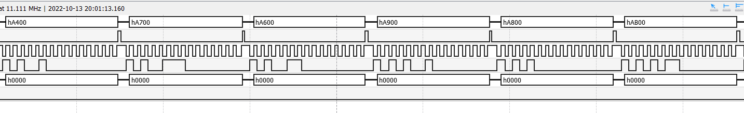


PROTOTYPING PROGRESS
SPI and I2c progress
SPI with LSM6DSOWTR 6-axis IMU has been tested and works
I2C with LiDAR Time of Flight Sensor has been tested and works, driver integration ongoing
Write:
Read:

Slide 46

PROTOTYPING PROGRESS
UART progress
Crossfire UART driver has been tested and can correctly decode receiver communications

Slide 47

PROTOTYPING PROGRESS
PWM progress
PWM has been tested with the ESC and the motors have spun already

Slide 48

PROTOTYPING PROGRESS
PWM progress

Slide 49


PROTOTYPING PROGRESS
Integration Progress
Integration of all the parts is in progress , but has not been completed yet

Slide 50

Software Development Status
Main Program Flowchart
Notes:
Just explain what is needed to do for each of the blocks, where each one is in testing/development. Also, elaborate on the entire integration of the project

Slide 51

Software Development Status
Sensor Fusion – complementary filter
IMU provides acceleration and angular rate in 3 axes
Angle can be calculated from acceleration (while not moving)
Angle can also be integrated from angular rate
Both options have problems
Can be combined with different filters, i.e. Complementary, Kalman, etc.
Notes:
Just explain what is needed to do for each of the blocks, where each one is in testing/development. Also, elaborate on the entire integration of the project

Slide 52

Software Development Status
PID Loop
Takes sensor data and computes controlled response to stabilize the drone
3 PID loops for Yaw, Pitch, and Roll stabilization
1 PID for throttle (based off ToF Z sensor data
2 PID (on Pi Zero) for spatial control (using ToF XY data)
Notes:
Just explain what is needed to do for each of the blocks, where each one is in testing/development. Also, elaborate on the entire integration of the project

Slide 53
Project Timeline
Goals over the next weeks
Week 8: Present PCB Design
Week 9: Order PCB and integrate software
Week 10: Full stack testing and test PCB if arrived
Week 11: Put together PCB
Week 12: Fully test assembled PCB
Week 13: Begin final hardware testing
Week 14: Thanksgiving Break
Week 15: Finalize hardware and software functionality
Week 16: Finalize hardware and software functionality and prepare for showcase week
Notes:
This is just a rough draft of a timeline. Change if needed but should give enough time for each task needed to complete the project. Can elaborate more if needed.

Slide 54

Project Timeline
Goals over the next weeks
Notes:
This is just a rough draft of a timeline. Change if needed but should give enough time for each task needed to complete the project. Can elaborate more if needed.

Slide 55
3D Printing
Questions?
Notes:
Prepare for LOTS (mainly probably going to be on why we made certain routing decisions, a review on the parts that we are using, testing protocol potentially, maybe elaborate more on what to expect to be finished by finalization and showcase time)

